Slide 1
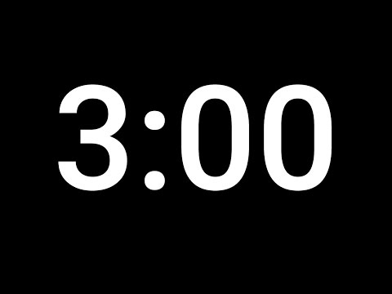
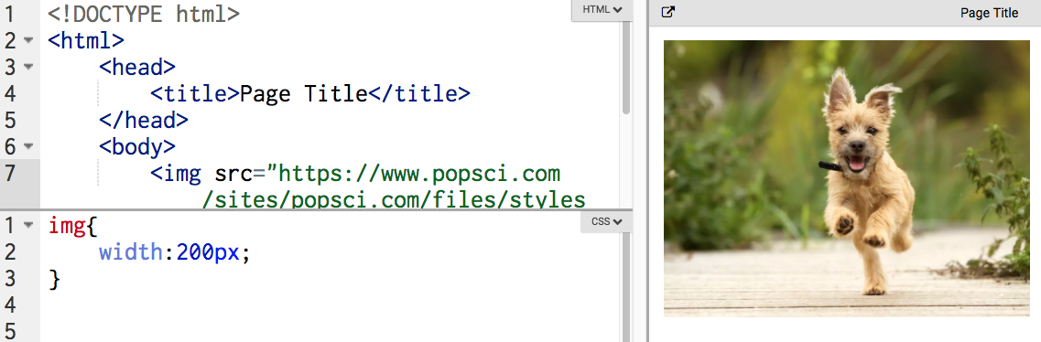
打开此代码。在CSS中，将第2行的200px更改为20px。 发生了什么变化？有什么不变？
https://popcode.org/?snapshot=2211fb89-cb51-4f7a-9a52-0b3ed0b52e7c
Computer

Slide 2
选择一个HTML元素，修改其CSS属性的值，更改其样式
Vocabulary: CSS, Selector, Property, Value, Rule, Style

Slide 3
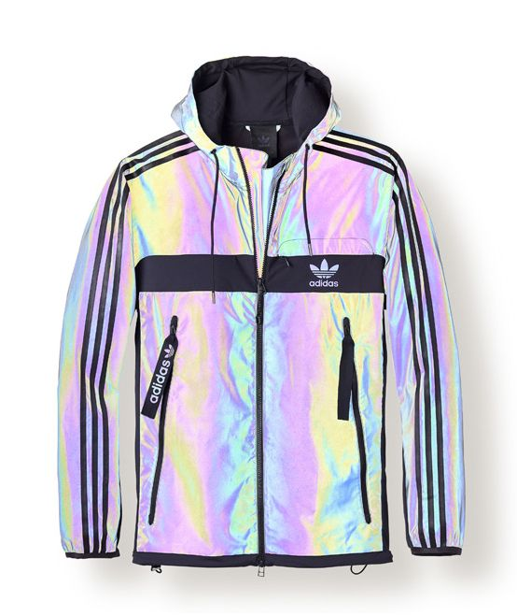


样式
Notes:
Ask students to take a moment and look at the jackets. What do they notice is similar between them? What is different?
What properties of each jacket let you know that it is Adidas? (Prompt for key words like logo/image, font of the word “Adidas”, the position of the three stripes)
What property changes did the designers make to make each jacket unique? (Prompt for key words like color, background color, size of logo/image, position of different elements, etc.)

Slide 4

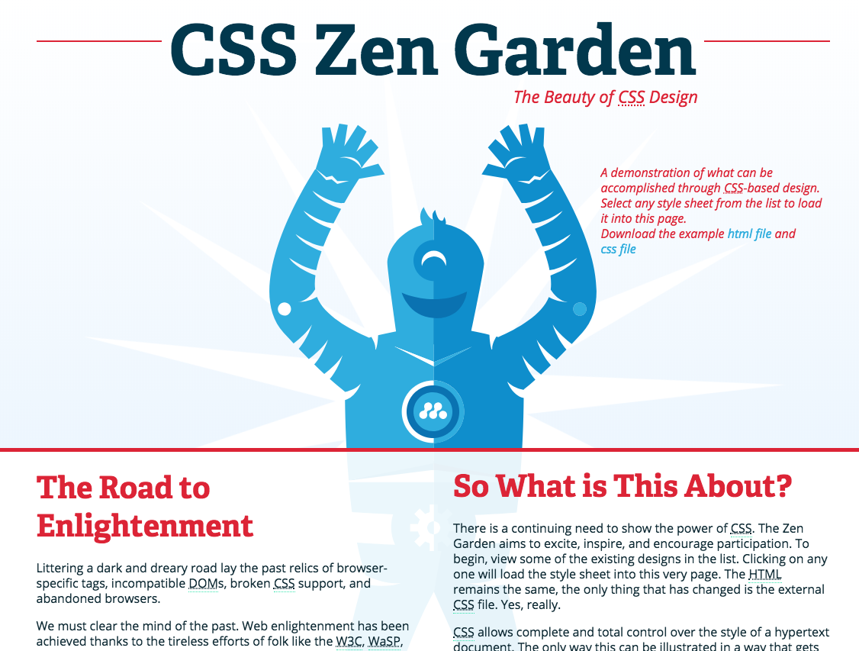
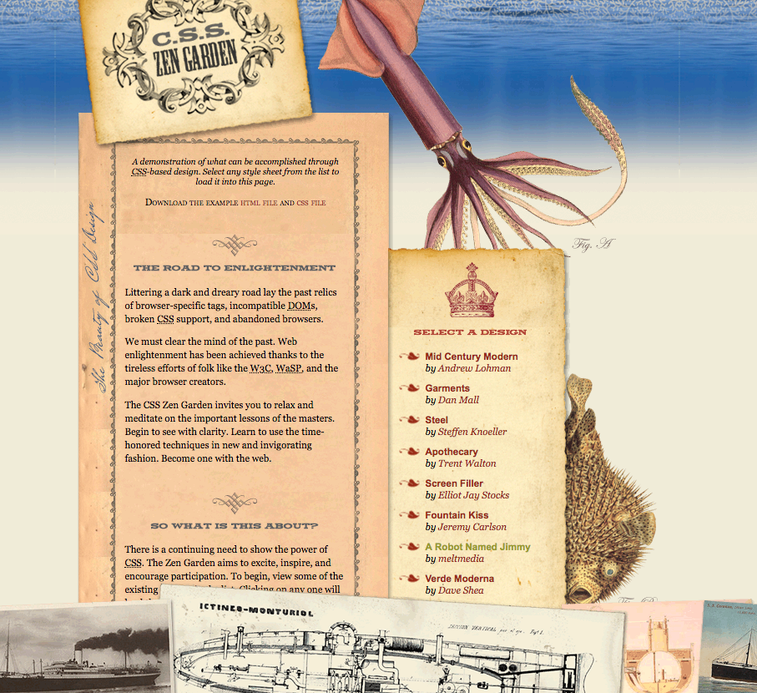
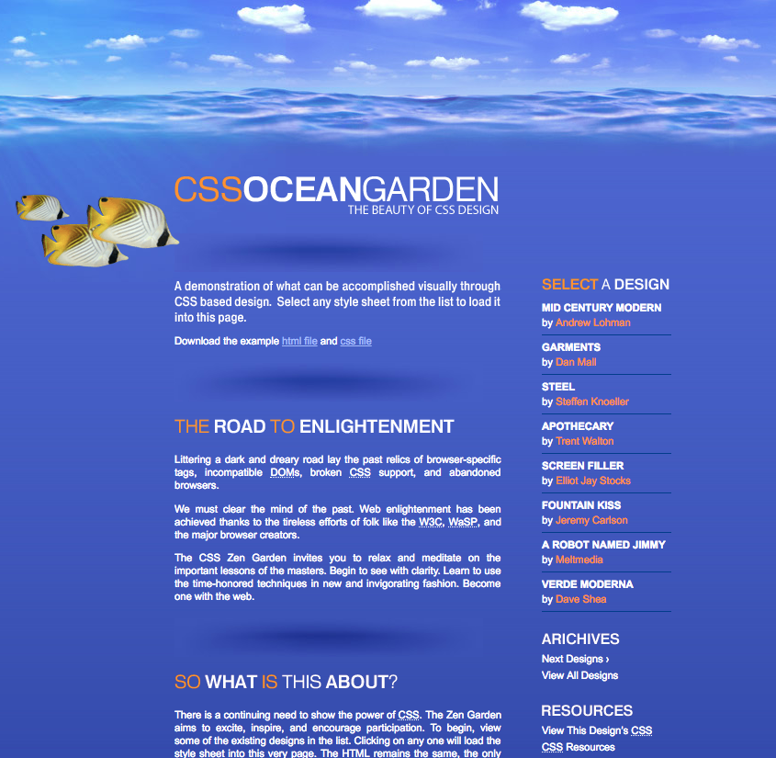
CSS
CSS赋予网站风格！
什么是风格？
颜色
间距
位置
动画
更多
Notes:
Images on the right are all the same content. But all different CSS. That's the power of styling.

Slide 5

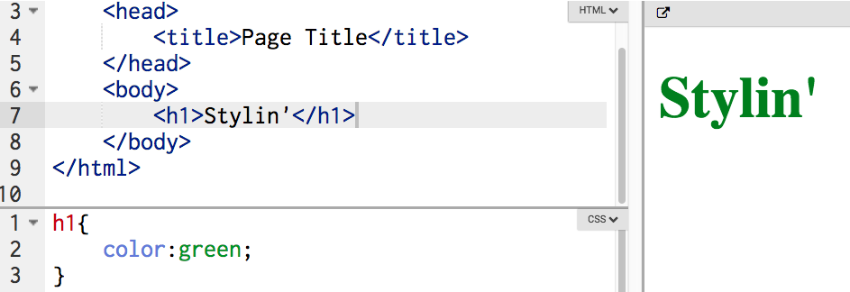
CSS 需要 HTML!
CSS和HTML是伙伴，它们在一起协同工作！
我们选择要在CSS中设置样式的HTML元素

Slide 6
CSS
selector 选择器选择我们要更改页面的哪一部分：
h1 {
}
选择网页上所有的h1元素
Notes:
What is the selector here?

Slide 7
CSS
接下来，我们指出我们要更改的属性：
h1 { color:
}
对于此网页上的每个h1，更改文本颜色。
Notes:
What is the property here? What does this property do?

Slide 8
CSS
最后，给属性一个值：
h1 { color:green;
}
对于此网页上的每个h1，将文本颜色更改为绿色。

Slide 9
CSS
属性和值一起称为规则。
h1 { color:green;
}
对于此网页上的每个h1，将文本颜色更改为绿色。

Slide 10
CSS
h1 {
color: green;
}
Selector选择器
Property
属性
Value
值
rule 规则

Slide 11
HTML vs. CSS 语法
HTML
CSS
< >
=
{ }
;
:
Notes:
Make sure to point out these symbols on the keyboard during guided practice

Slide 12
用哪个选择器来更改“怎么了？”变黄？
<h1>嘿</h1>
<h2>怎么了？</h2>
<p>你好</p>
h2 {
color:yellow;
}
Notes:
this slide animates!

Slide 13
用哪个选择器将“你好”更改为绿色？
<h1>嘿</h1>
<h2>怎么了？</h2>
<p>你好</p>
p {
color:green;
}
Notes:
this slide animates!

Slide 14
将页面上的所有<h3>标记更改为红色，用什么CSS代码？
a. h1 {
color: red;
}
b. h3 {
color; red:
}
c. h3 {
color: red;
}
<html>
<body>
<h3>Hey!</h3>
<h3>What's up?</h3>
<h3>How ya doin?</h3>
</body>
</html>

Slide 15
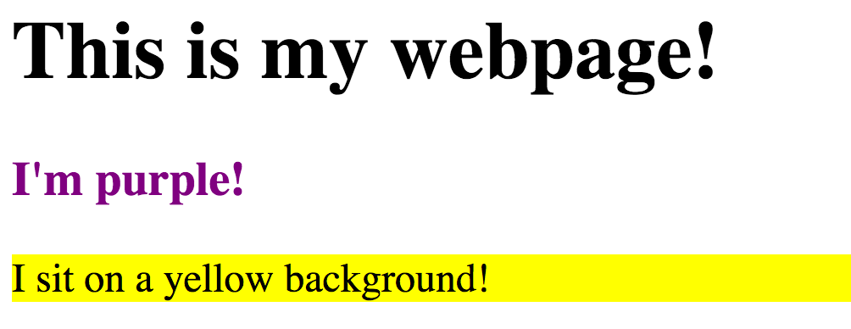
将页面上任何段落的背景颜色更改为黄色：
1
Paper
p {
background-color : yellow ;
}
2
3
4

Slide 16
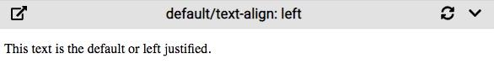
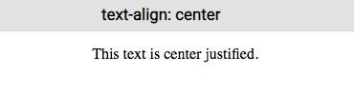
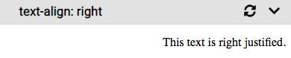
使用text-align属性可以将文本放在左侧，中间或右侧。
p {
text-align: right;
}
将这些属性添加到<body>标记将使页面上的所有内容合理。

Slide 17
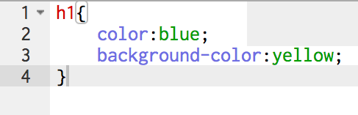
一个选择器可以具有多个属性和值。
Notes:
What is the selector? What is the property? What is the value?

Slide 18
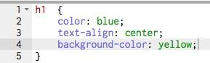
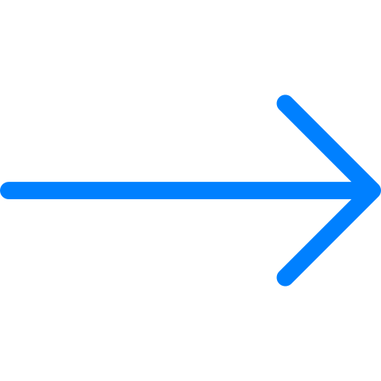
将每个CSS属性放在新行中
使用[tab]键缩进每一行
添加多个属性时，请遵循良好的格式规则，这一点很重要。
Notes:
Talk about why good style is important: It makes it easy to see which styles have been applied and it makes it easier to debug. This is especially important when you start working on projects with other coders.

Slide 19

a. img {
height: 200px;
width: 100px;
}
b. img {
height: 200px;
wide: 100px;
}
c. pic {
height: 200px;
width: 100px;
}
哪个CSS代码可使此图像的宽度为100px，高度为200px？
200 px
100px

Slide 20
css-cheatsheet

Slide 21

练习：解码秘密消息
Notes:
Open this popcode and review the code briefly together so students understand their task.
students cannot use black for the font color

Slide 22
练习：
您最喜欢的歌手/乐队正在演奏音乐会，他们聘请您制作了海报来为演出做广告。
Notes:
Lead students through these steps:
1. Change the HTML to the artist and venue of your choice.
2. Update the image with a picture of your artist.
3. Choose at least **5 different CSS properties and values** to style your html elements.
If you have time,
* Add a link to a video of the artist's best song
* Google ":hover" property selector, and see what you can do with it!
* Try Experimenting with these CSS Properties! What do they do?
- text-decoration (underline, overline, line-through)
- text-align (center, left, right)

